Slide 1
STEPS TO SUBSTITUTE CERTIFICATION
With Mrs. Vieselmeyer
Office #224
Vieselmeyer-j@mssu.edu
417-659-4318
The following presentation will explain the following steps:
Step 1: Create DESE profile
Step 2: Apply for Substitute Certification
Step 3: Send transcripts to Missouri DESE
Step 4: Fingerprinting/Background Check

Slide 2
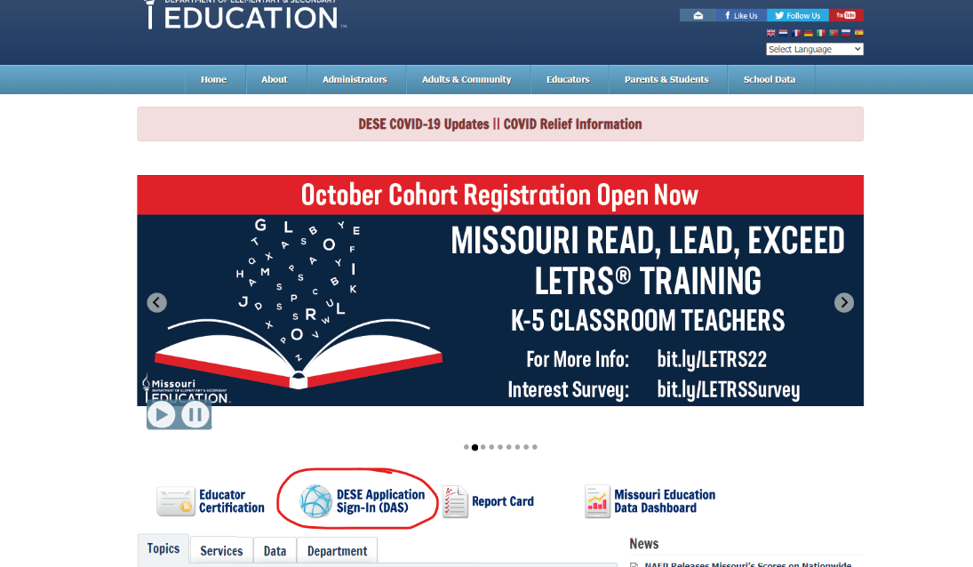
PART 1: ONLINE SUBSTITUTE CERTIFICATE APPLICATION
Step 1: dese.mo.gov
Step 2: click on DESE Applications Sign-In(DAS)

Slide 3
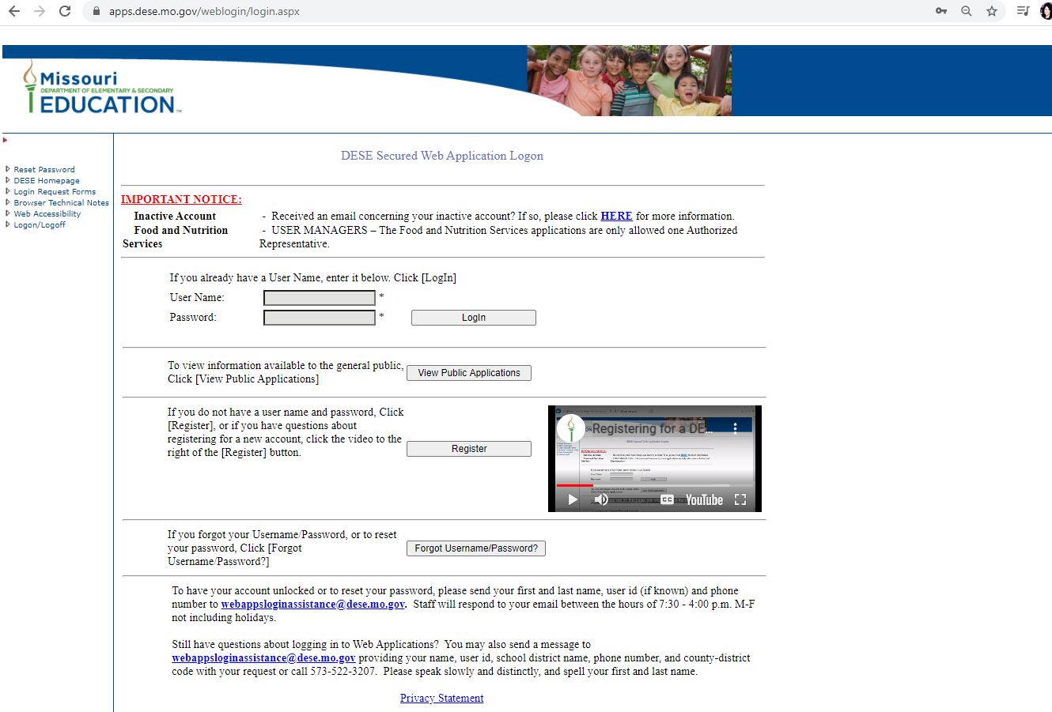
Step 3: If you do not have a DESE profile created: click on the register button
(if you already have a DESE profile you will just login up above)

Slide 4
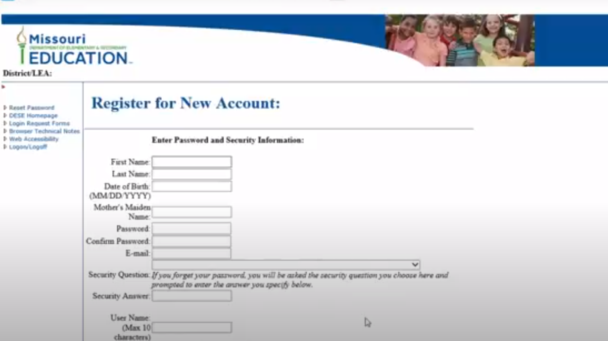
Step 4: Register for New Account
Fill in your information in the boxes provided
*word of caution: your password must only contain letters and numbers
*please use personal email

Slide 5
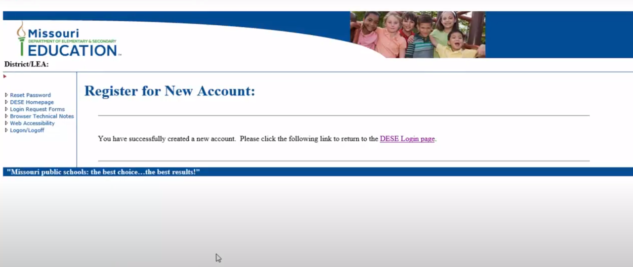
Step 5: When you arrive at this page, you have successfully set up your new DESE profile account
Click on the DESE Login

Slide 6
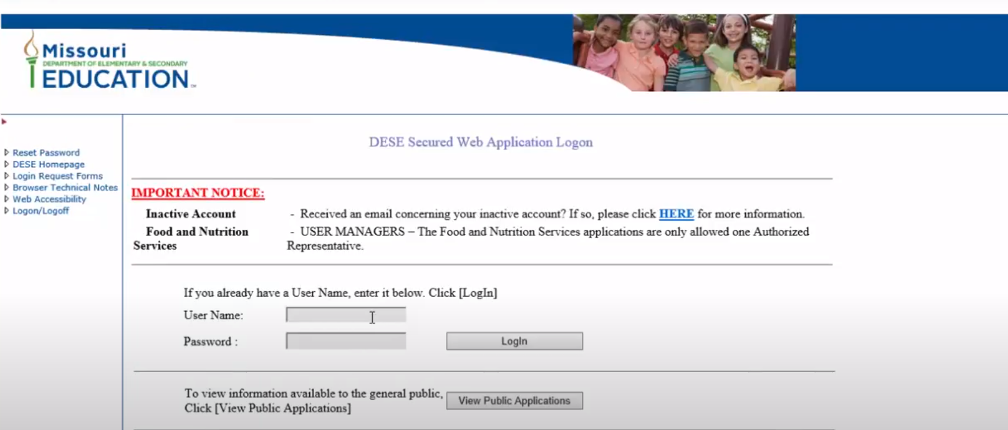
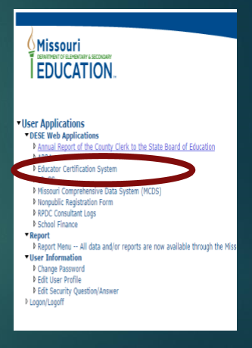
Step 6: You will now log in with your username and password you just created
After you click login, it will take you to this page and you will click on Educator Certification System

Slide 7
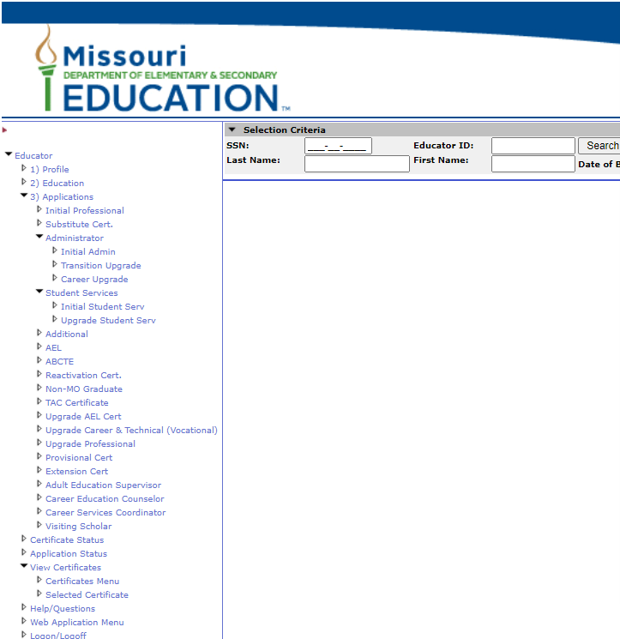
Step 7: Your information should show up here, if not click on profile and fill it in
Now you are ready to apply for your substitute certification
Under Applications:
Click on the Substitute Cert

Slide 8
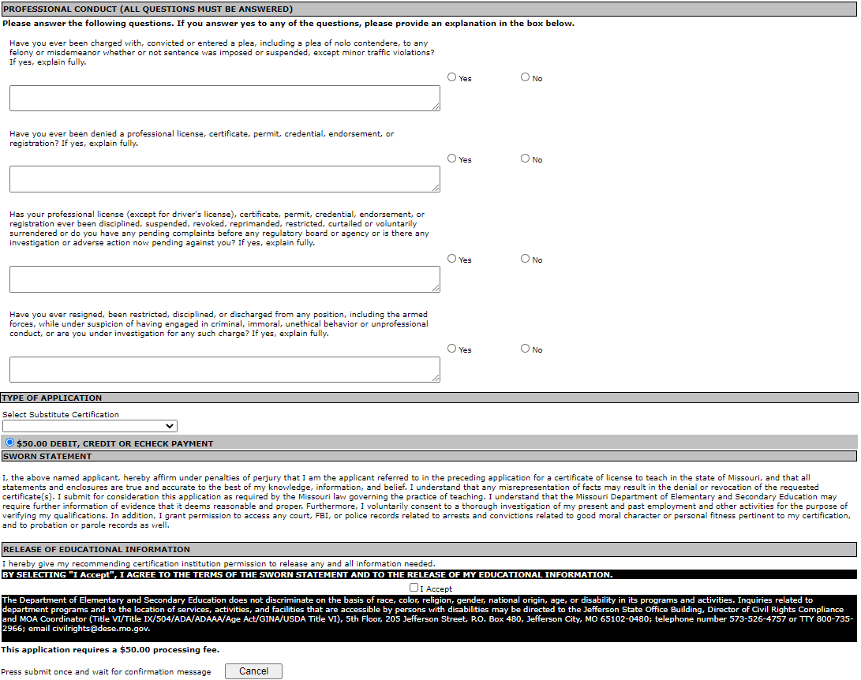
Step 8: Answer the following questions
Step 9: Pay for your substitute certification

Slide 9
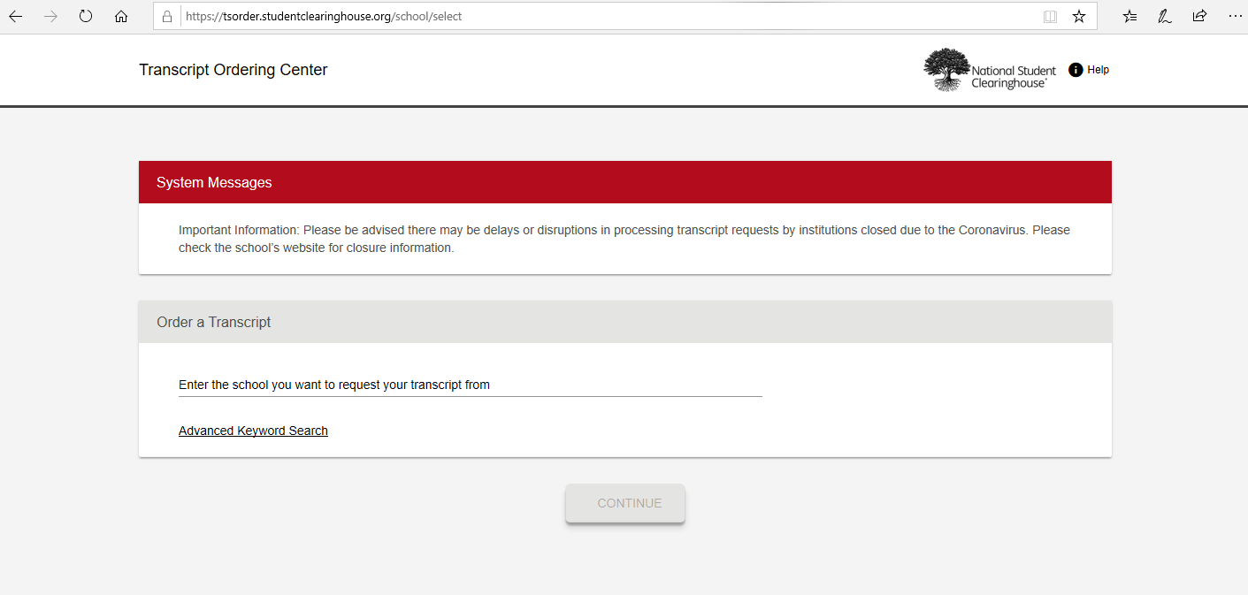
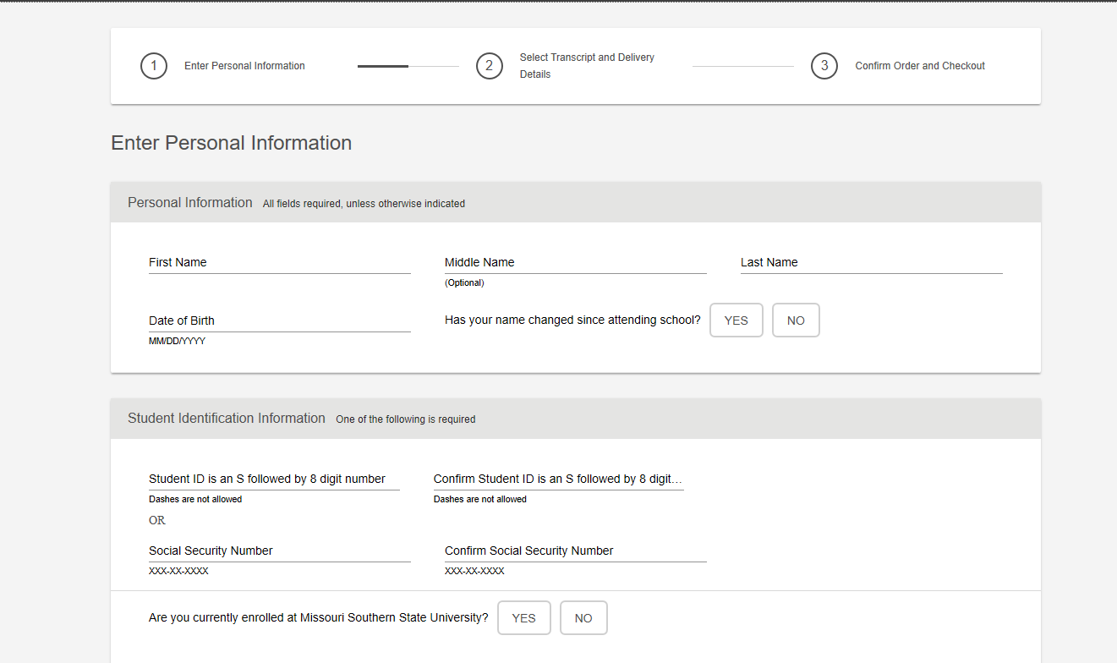
PART 2: REQUIRED SUPPORTING DOCUMENTATION (SENDING TRANSCRIPTS)
Step 9: Send transcripts from MSSU(at least 36 hours) to Missouri Department of Elementary and Secondary Education
Order your official transcript National Student Clearinghouse at:
  https://tsorder.studentclearinghouse.org/school/select
Enter Personal Information

Slide 10
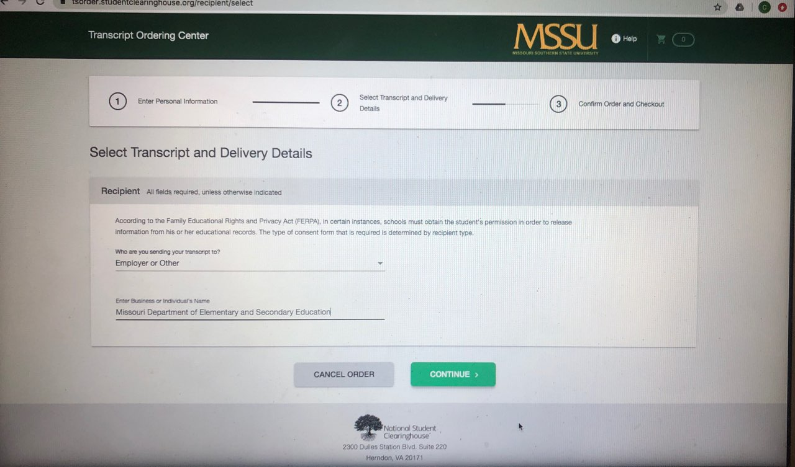
  Transcript and Delivery Details
    Please look for Missouri Department of Elementary and Secondary Education
  You may use EFX-Electronic File Exchange on National Clearinghouse to send transcripts or you can choose to mail them to PO Box 480, Jefferson City, MO 65201(mailing them will take longer)
If the institution you have attended is not on NCH website, you will need to reach out to the institution and request your transcripts be sent to
  Missouri Department of Elementary and Secondary Education
  PO Box 480
  Jefferson City, MO 65201-0480

Slide 11
PART 3: FINGERPRINT/BACKGROUND CHECK
A criminal fingerprint/background clearance must be obtained before a certificate can be issued.
Please follow the steps to Fingerprint/Background check here:
https://dese.mo.gov/media/pdf/oeq-conductinvestigations-backgroundcheckprocedures
Please use the generic code of 2301unless you know a district that you are going to sub in, then call the district and ask for their 4 digit code.

Slide 12
Check your DESE profile weekly for any updates to your substitute certification application.
If you have questions please reach out to
vieselmeyer-j@mssu.edu

