Slide 1
2010 Accomplishments and Vision
March 2011
Board Retreat

Slide 2
2010 Accomplishments
February 2010, I outlined a vision for MSSU, and the following components of that vision have been accomplished:
Through a campus-wide process, we have established the goals and objectives of the strategic plan for 2011-2016.
Through the same process, we have developed a framework for shared governance and are soliciting feedback for promoting shared governance.

Slide 3
2010 Accomplishments
MSSU now has a division of Student Affairs overseen by a Vice President for Student Affairs. HLC recommended that change, and the Board agreed. A search for a permanent VP for Student Affairs is underway.
The Vice President for Academic Affairs was selected through a national search, and I am happy to say that AJ is doing an exceptional job.

Slide 4
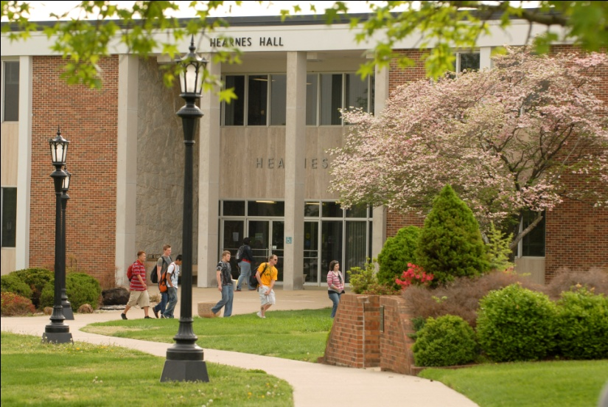
2010 Vision
The one-stop shop for students is being made possible through the renovation of Hearnes Hall.
A one-stop shop is common on university campuses.
The one-stop is one of our efforts to serve students effectively.

Slide 5
2010 Accomplishments and Vision
The Leadership Academy is in its second year, and the President’s Council receives regular reports on the progress of the Academy.
The Academy is focusing on creating and maintaining a shared institutional leadership strategy which will ultimately provide inspiration to the leaders of the campus community.
The Academy is using John C. Maxwell’s Developing the Leader within You as a guide for interactive discussions. The Academy class of 2010-2011, which meets monthly, includes ten campus employees from faculty and staff. Five members of the inaugural class of 2009-2010 serve as mentors for the current class. A six-member steering committee of previous graduates set up the curriculum, and each facilitates one lesson during the academy.

Slide 6
2010 Accomplishments and Vision
Our fundraising has exceeded expectations, with two substantial seven-figure gifts from the Plaster Foundation. In fact, fundraising has taken hold in various departments, including athletics, music, and international.
My goal is to devote more of my time to fundraising.
Successful fundraising is crucial to Southern’s success.

Slide 7
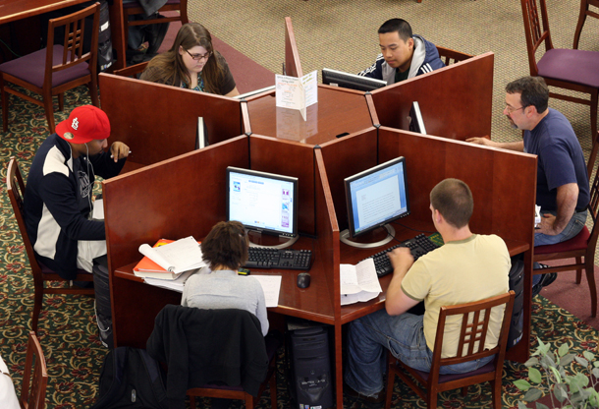
2010 Accomplishments and Vision
Enrollment has generally increased.
Spring 2011 enrollment decreased.
We anticipated this decrease due to the increase in the tuition rate and fees associated with the online programs.
Online instruction is being reinvigorated to ensure that Southern can gain more market share in online education.

Slide 8
2010 Accomplishments and Vision
Southern is increasingly engaged in the Joplin-metro community, especially with our involvement in Bright Futures.
We have continued a Vista-Americorps grant that was previously funded for two years because of Southern’s commitment to the critical importance of this type of high impact learning.
We have added a Coordinator of Service Learning to enhance our ability to engage the Joplin-metro community in a multitude of ways while providing our students with hands-on, learning opportunities that impact student success.

Slide 9
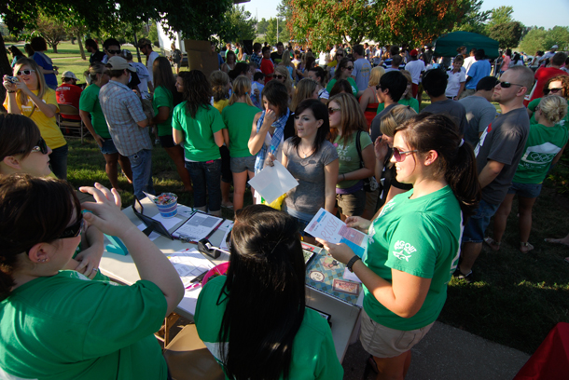
2010 Accomplishments and Vision
We established customer training throughout the campus, emphasizing “students first.”

Slide 10
Vision
As we move forward, my vision is for Southern to be distinguished as a student-centered institution. To achieve that vision, I will pursue the following:
Invest in training that stresses “students first.” Deans, department chairs, and directors will lead the effort to promote “students first” with the goal that all employees at Southern will put “students first.”
Such investment will include bringing speakers to campus for workshops and sending leaders to conferences.

Slide 11
Vision
Continue to support our outstanding theme semester program. This unique effort is vital to promoting internationalization on campus. The next four theme semesters are: Egypt, Thailand, Italy and Turkey.
Seek a tuition waiver to ensure that Southern has the financial resources necessary to operate successfully.
We have legislative support for an increase.
We have excellent justifications for asking for an increase.

Slide 12
Vision
Establish a Dean of Enrollment Management to ensure that we can coordinate the recruitment and retention of students.
Current six year graduation rate is 32.7%.
Challenges/opportunities will be unique to Missouri Southern and SW Missouri.
Such a position is common on most campuses.
Student success requires coordination of our enrollment management efforts.

Slide 13
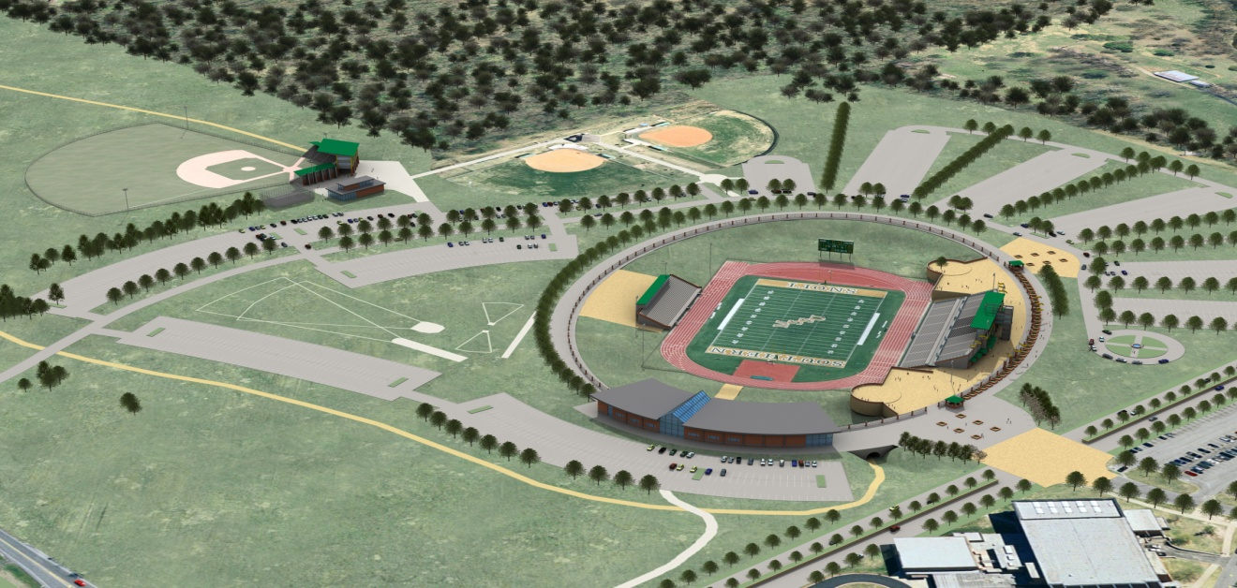
Vision
Raise sufficient money to ensure that we reach our goal of constructing a new baseball complex and an end-zone facility.

Slide 14
Vision
Promote and support the establishment of a medical school at Southern.
The 501(c)3 that was established continues to express high interest in a medical school.
We are exploring partners at this point.

Slide 15
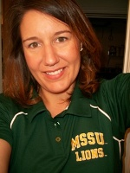
Vision
Complete the HLC focus visit in April.
The campus has worked very hard to prepare for the visit.
Susan Craig, in particular, has been a great asset in making sure the focus visit is successful.

Slide 16
Vision
Continue to build teamwork and collegiality at Southern to serve students well.
My message is unambiguous: I expect teamwork at Southern.
Effective teamwork includes a vigorous discussion of ideas with transparency, but it does not include dissension that is unproductive for the university. We are all obligated to be good colleagues.

Slide 17
Vision
Establish a comprehensive list of policies and procedures and their regular and ongoing review for the successful operation of Southern.
The purpose of such a list is to ensure that we all have access to the rules and regulations for conducting business.
When followed faithfully, effective policies and procedures ensure fairness in decision making.

Slide 18
Vision
Promote continuous quality improvement.
Create a culture of training to do one’s job, effectively and holistically and to contribute to “student success” beyond one’s departmental assignment.
Our strategic plan will guide us as we continue to improve every effort to promote student success.
We must evaluate every aspect of the university to keep us moving forward in our service to students, i.e. “students first.”

Slide 19
Formation of Steering Committee announced on Sept. 10, 2010 to plan the University’s 75th Anniversary Celebration in 2012-2013. Dr. Mark Parsons is serving as Chair of the Steering Committee. The committee's charge is to provide a fun-filled academic year (’12-’13) of activities and events that celebrate our pride in MSSU’s history, people and traditions that tell the story of its remarkable growth since its founding in 1937 as Joplin Junior College.

Slide 20
Any questions ?

