Slide 1
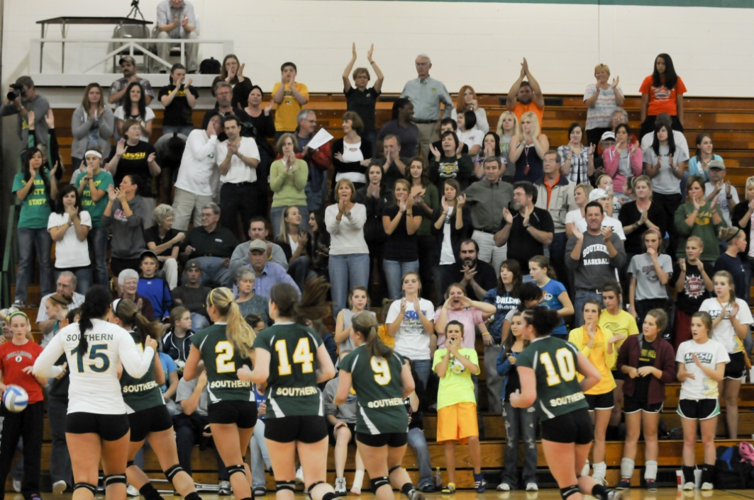
Missouri Southern Athletics
Missouri Southern State University:
Board of Governors
March 19, 2011

Slide 2
Academic Numbers Fall ’10
 | # OF | Fall |  | Fall
 | STUDENT | 2010 | Cumulative | 2010
SPORT | ATHLETES | GPA | GPA | 4.0's
Baseball | 35 | 2.912 | 2.873 | 3
Cheer/Dance | 25 | 2.520 | 2.588 | 5
Men's Basketball | 15 | 2.671 | 2.466 | 1
Golf | 10 | 2.847 | 2.790 | 1
Men's CC/TF | 43 | 2.836 | 2.627 | 4
Post El's | 9 | 2.906 | 2.861 | 0
Softball | 22 | 3.213 | 2.793 | 2
Trainers | 13 | 2.598 | 2.616 | 0
Volleyball | 16 | 3.387 | 3.237 | 5
Women's Basketball | 13 | 3.092 | 2.613 | 0
Women's Soccer | 23 | 3.339 | 3.201 | 4
Women's CC/TF | 36 | 3.192 | 3.203 | 10
Football | 108 | 2.194 | 2.302 | 2
 | 368 | 2.90 | 2.78 | 37
Notes:
Info from Academic Committee Fall 2010 Grades report. Only SA’s used as defined by the academic committee for highest team GPA award.

Slide 3
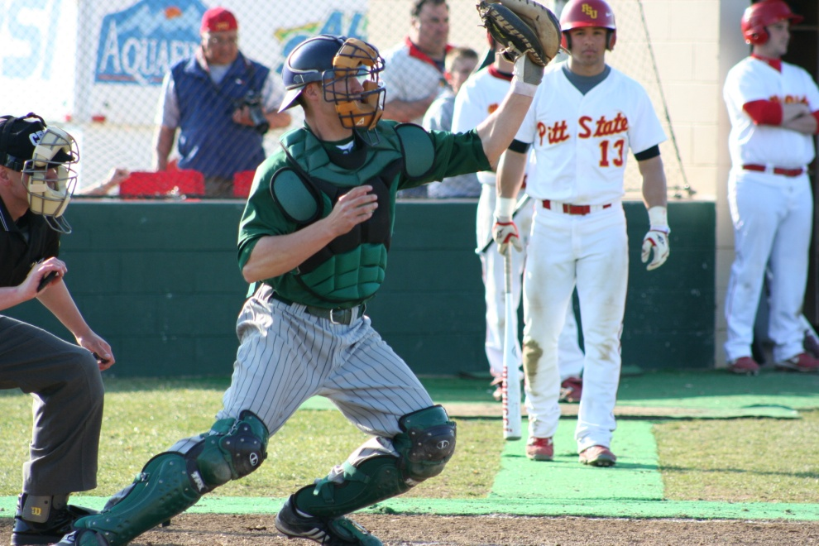
Academic Numbers in degree programs- 2011
Name of Degree | Total # of SA's | % of SA's
Communication, Journalism | 17 | 4.6%
Computer & Information Sciences | 3 | 0.8%
Education | 70 | 19.1%
History | 1 | 0.3%
Liberal Arts & Sciences, General Studies & Humanities | 4 | 1.1%
Biological Sciences & Biomedical Sciences | 32 | 8.7%
Parks, Rec & Leisure Studies | 58 | 15.8%
Physical Sciences | 1 | 0.3%
Science Technologies | 2 | 0.6%
Psychology | 4 | 1.0%
Homeland Security, Law Enforcement, Firefighting & Related Protective Services | 42 | 11.4%
Visual and Performing Arts | 3 | 0.8%
Health Professions & Related Programs | 28 | 7.6%
Business, Management, Marketing & Related Support Services | 59 | 16.1%
Undeclared | 40 | 10.9%
Notes:
Run Degrees and SA’s Adhoc report in CA, import into Excel, delete blank columns for sport, and run figures.

Slide 4
Academic Award Numbers
In 2010-11:
Eight Academic National Scholar Athlete Selections (spring sports yet to be awarded)
Three teams earned Team Academic Awards through their respective coaches associations
Over 100 MIAA Academic Honor Roll Selections
One Elite 88 Winner for the best GPA for any participants in a national tournament (playoff)- Victoria Kline (4.0 graduating Snr.)

Slide 5
Participation Numbers for our student-athletes
Sport | # Participants*
Baseball | 35
Football | 126
Men's Basketball | 15
Men's XC/Track & Field | 44
Men's Golf | 14
Women's Basketball | 13
Women's XC/Track & Field | 36
Women's Soccer | 26
Softball | 22
Volleyball | 16
Total | 347
*Unduplicated count
Notes:
Sports only – used numbers from Compliance Assistant (search by sport). This will be different from the Academic numbers b/c 1. No cheer/dance, no post els and no trainers included. 2. Some people who participated could have quit and were not included on the academic data count. 3. Mid-year transfers have been added to CA and were not on fall grades list.

Slide 6
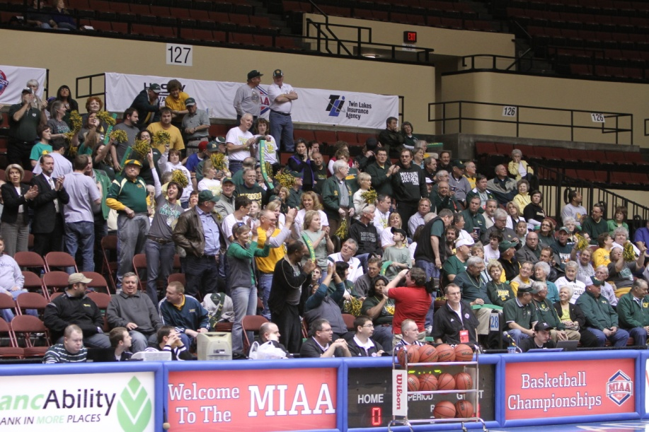
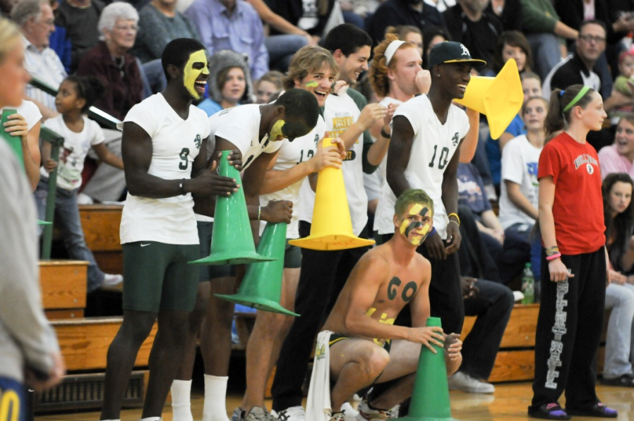
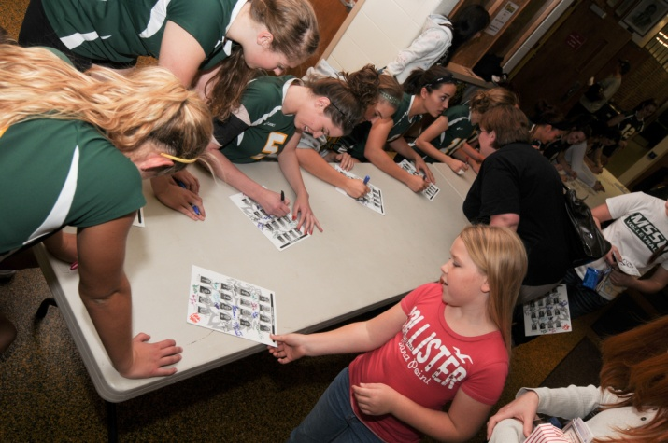
Increased Community Involvement and Fundraising Focus

Slide 7
The 2010 MSSU Hall of Fame Inductees
Shally Lundien Softball (1994-95)
Dalana (Lofland) Rutledge Cross Country/Track and Field (1994-98)
Albert “Juice” Bland Football (1993-95)

Slide 8
Student- Athletes in the Community
Special Olympics (Track and Field)
Special Olympics (Bowling)
Community Blood Drive
Breast Cancer Awareness Night
Adopt-a-Street Program
MIAA Canned Food Drive
River Clean-Up
Charity Prom Event
Free Fall Basketball Clinic
JACS Basketball Clinic
Salvation Army Clothing Drive
FCA/Boys' and Girls' Club Christmas Party
MIAA Basketball Tournament - Operation Breakthrough (2008) Harvester's (2009)
Lafayette House - (Battered Women and Children)
Cerebral Palsy of Tri-County
MLK Day of Service
Sarcoxie Youth Sports
Since May 1, 2010 we have departmentally amassed more than 3,500 documented hours of community service by our student-athletes & staff

Slide 9
Lionbacker Organization Results
Membership LVL | Starting Line Up ($100) | Team Cpt. ($300) | All- Conference ($600) | All-American ($1200) | National Champion ($2500) | Hall of Fame ($5000) | Legendary ($10000)
Members | 104 | 71.67 | 43.5 | 4.0 | 1.0 | - | 1.0
Contributions | $10400 | $21500 | $26100 | $4800 | $2500 | - | $10000
Total # of LB’s | 224 | This is the down 16 (including corp) |  |  |  | Lionbacker Donation Total | $81033
Non-Member Season Tickets | $5733 | LB Season Tickets | $49000 | Total Season Tickets | $54733 | Season Tickets Down$17000 from last year | Donations up $75300 from last year
Average LB Donation | $334.42
Average LB Total Spent | $552.04
This tells us: 1. LB are joining the membership club ; 2. There membership seems to be based on benefits and/or support of athletics; 3. they are picking their sport/ticket packages of preference (more ala carte) 4. Corporate Sponsorship is tied to both membership and marketing

Slide 10
SouthernFest-A Financial & Public Relations Success
Over 300 supporters attended Dinner/Auction and 42 teams played in golf tournament.
Two-day event generated nearly $40k.
All title and presenting partners have renewed for SouthernFest ‘11.
SouthernFest ‘11: Thursday, July 28 and Friday, July 29 at Downstream and Eagle Creek Golf Course.

Slide 11
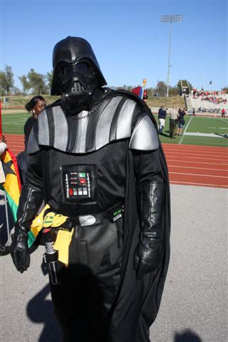
Other events that have an increased focus on Fundraising and Social Events
SouthernFest ’11
Lions & Lures
Football Alumni Golf Tourney
Athletic Alumni Reunion
Hall of Fame Induction Ceremonies
Lionpride Luncheons
Post game Socials in Joplin and KC
Homecoming as a stand alone event

Slide 12
Fundraising Efforts
Athletics had $172,000 in deposits into the Foundation for the calendar year of 2009
We increased that amount to $246,000 for the calendar year of 2010

Slide 13
Corporate Sponsorship Focus
In FY10, we billed just over $100k in corporate sponsorships. For FY11, we will bill at least $117,120. This has been accomplished despite limited success in high profile sports in the ‘09-’10 season. We will attempt to bill at least $135k in FY12.

Slide 14
Exposure: On-Campus and Off
We drew over 49,000 fans to our campus for football and basketball games alone this year. This is an average of 2,133 people per event.
Coverage of MSSU Athletics by our local media is on a near daily basis and helps create “top of the mind awareness” and a familiarity in the community. We currently have positive daily articles and reports!
Walking billboards
Getting our brand out into the community

Slide 15
Update on athletic website
Able to provide more video and audio functions to fans
Allows for easier updating from any computer with an internet connection
Better fan interaction with polls/posting
Avenue for text and email updates and alerts
Creates more diverse and varied tabs to better service the needs of sports, fundraising, marketing, etc…
Allows for advertisements and revenue generation(sales) in a nice clean and pleasing way
http://www.mssulions.com

Slide 16
Thanks for your time!
Any Questions?

