Slide 1

Advancement Division Report to Board of Governors
March 19, 2011

Slide 2
Agenda
Website Launch Achievement
Alumni Association Connections
Foundation Activity
Resource Center Development
Southern Annual Fund Success
Major Gifts Accomplishments
Other Campus Fundraising
Future Goals

Slide 3
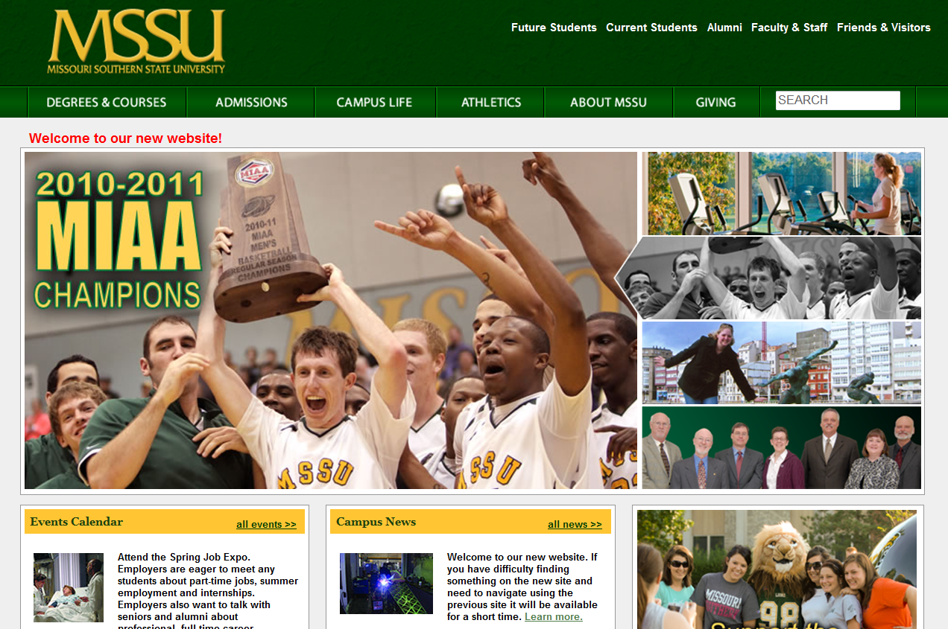
Website Development
WOW!!

Slide 4
Website Launch Achievement
Goal #1 - Improve Web Management Resources
  Achieved through acquisition of Content Management System – OmniUpdate
  Administrative commitment demonstrated by providing additional Web resources – Web Coordinator and Part-time Web Specialist
Goal #2 - Update Website Design
  Partnered with Stamats, national higher education consulting firm, in two-phase process – Discovery and Website design services
  “Wow” factor achieved!

Slide 5

comments:
“I love the new website!”
“Nice new web page … i like it ..”
Notes:
Your new site is terrific!! I plan to share this with other clients that are interested in doing design and architecture only.
Your team did an incredible job implementing our design and architecture.
From Pegi Anton, Senior Vice President, Stamats, “Please thank them from Stamats on doing such a great job. (I cannot imagine you will get any negative feedback on your revised site.) It really looks good.”

Slide 6
Website Analytics
Former Website:
  Visits:
    231,907 (Nov. 22, 2010 – Dec. 21, 2010)
    255,686 (Jan. 21-Feb. 20, 2011)
  Up 47.11% from previous month
  30.28% New Visits
  70% Bounce Rate

Slide 7
Website Analytics
Redesigned Site in FIRST TWO WEEKS:
  80,895 visits
    2,609.52 Visits / Day
  37.00% New Visits – UP 15%
  57.66% Bounce Rate – DOWN 13%
  Over 2:25 Time on Site – UP & CLIMBING!
  Visitors from virtually every state in the Union:
    98 from Connecticut; 212 North Carolina; 486 Florida;
    2,427 Kansas; 61,611 Missouri
  Nearly every nation on the globe:
    Ethiopia 5; Russia 52; China 150; Nepal 16
Notes:
Bounce rate is declining almost daily. Time on site climbing daily. Absolute Unique Visitors give information on what percentage of visitors website retains within a given date range.

Slide 8
Let’s take a tour...

Slide 9
MSSU
Alumni Association
Notes:
Some statistics regarding the Alumni Center’s successes:
We have had over 2000 registered visitors through the Alumni Center since we opened the doors. This includes all of our new Freshmen who have had a class held in the center, viewed the Historic Video that was produced by Brad Belk and the Alumni Association and underwritten by alumnus and Board of Governor David Jones.
Work is underway on a custom built Alumni Association Board table. This table will hold the original gates from the William Randolph Hearst Collection that were a part of the original Mansion area. This is a gift in memory of Curt Betebenner by his high school graduating class of Webb City and by his wife, Elizabeth.
Another addition to the Alumni Center will be a custom built Welcome Center desk. This gift is made possible by Don and Gloria LaFerla.
As items are needed for the center, the Alumni Association provides that information to potential donors. To date, all outside benches, one of four planters and three garden areas have been underwritten.
“Dress the House” will be an event on April 16th where alumni and friends can drop by to view the dishes and other needed household items and purchase them by making a donation to the MSSU Foundation for that specific purchase. Gloria LaFerla and other friends of MSSU are helping with this project.

Slide 10
Success Stories of 2010-2011
Ralph L. Gray Alumni Center completion
Increased Donations
CASE Silver Award
Graduation Matters Program
Long Range Planning in Progress
Crossroads Magazine
75th Anniversary Book & Events
Notes:
2010-2011 has been a great success story for the MSSU Alumni Association. As you know, the Ralph L. Gray Alumni Center was opened on September 18th and had a variety of open houses for a variety of donors, alumni and constituents. Since the opening, the Alumni Association has received increased donations for the Alumni Center. Because alumni now have a permanent home on campus, they are able to see how the Association interacts with the campus and how they can become involved upon graduation.
The Alumni Association received a Silver Award from CASE in January. The Council for Advancement and Support of Education (CASE) is the professional organization for advancement professionals at all levels who work in alumni relations, communications and marketing, fund-raising and other areas. Case VI (Mid America District VI) represents the states of Colorado, Iowa, Kansas, Missouri, Nebraska, North Dakota, South Dakota and Wyoming. The Award won by Missouri Southern's Alumni Association was for the category of "Alumni Association Special Events" for the grand opening of the Ralph L. Gray Alumni Center. There were over 600 entries from colleges and universities, with 190 total awards given.
Graduation Matters - The Missouri Southern State University Alumni Association provided Carthage High School with green and gold MSSU pennants to hang above the doors of classrooms of teachers and counselors who have graduated from Missouri Southern. The goal is to provide an atmosphere that will help students understand the importance of high school graduation. This came as a request from CHS Principal and MSSU Alumnae, Kandy Frazier, who is putting all alma maters above the teachers’ classroom doors. The Alumni Board is considering this as a new project for outreach to other area schools, as well as possibly co-hosting an Education Department reception and providing a pennant to each teacher for their classroom. This will be discussed for the long range plan.
The Alumni Association is in the process of reviewing and revising its five-year long range planning. Committees are forming and looking at ways to further support Missouri Southern, enhance scholarships for students and support the mission, tradition and pride of Missouri Southern State University.
Publications are also a big part of the Alumni Association’s work, including Crossroads and the upcoming 75th Anniversary Book.

Slide 11

Ralph L. Gray Alumni Center
Move into new center September 18, 2010
Visitors to Alumni Center since opening over 2,000
2010-2011 UE Classes viewed Historic Video at Alumni Center
Alumni Board Table underwritten more than 100% of request
Alumni Welcome Desk underwritten more than 100% of request
All benches underwritten
One of four planters underwritten
Three gardens underwritten
Dress the House event on April 16, 2011
Notes:
Some statistics regarding the Alumni Center’s successes:
We have had over 2000 registered visitors through the Alumni Center since we opened the doors. This includes all of our new Freshmen who have had a class held in the center, viewed the Historic Video that was produced by Brad Belk and the Alumni Association and underwritten by alumnus and Board of Governor David Jones.
Work is underway on a custom built Alumni Association Board table. This table will hold the original gates from the William Randolph Hearst Collection that were a part of the original Mansion area. This is a gift in memory of Curt Betebenner by his high school graduating class of Webb City and by his wife, Elizabeth.
Another addition to the Alumni Center will be a custom built Welcome Center desk. This gift is made possible by Don and Gloria LaFerla.
As items are needed for the center, the Alumni Association provides that information to potential donors. To date, all outside benches, one of four planters and three garden areas have been underwritten.
“Dress the House” will be an event on April 16th where alumni and friends can drop by to view the dishes and other needed household items and purchase them by making a donation to the MSSU Foundation for that specific purchase. Gloria LaFerla and other friends of MSSU are helping with this project.

Slide 12
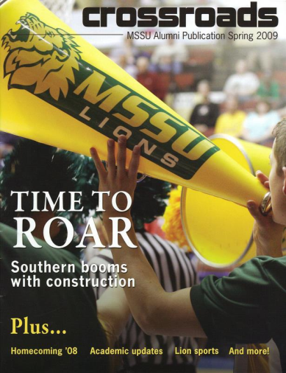
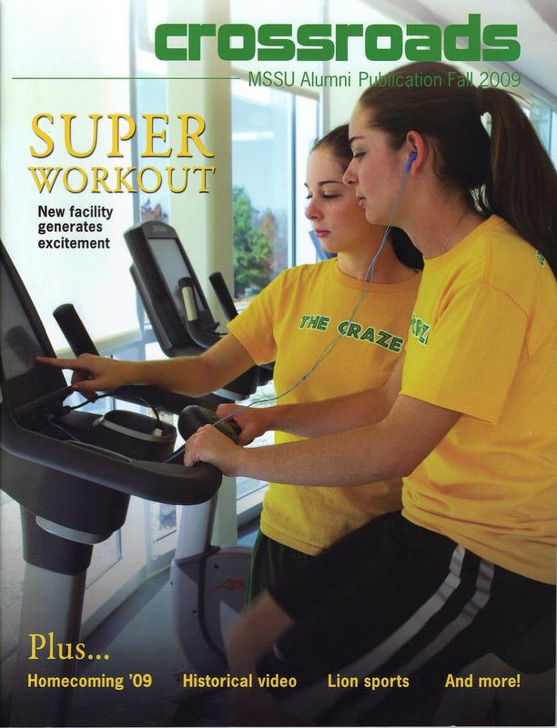
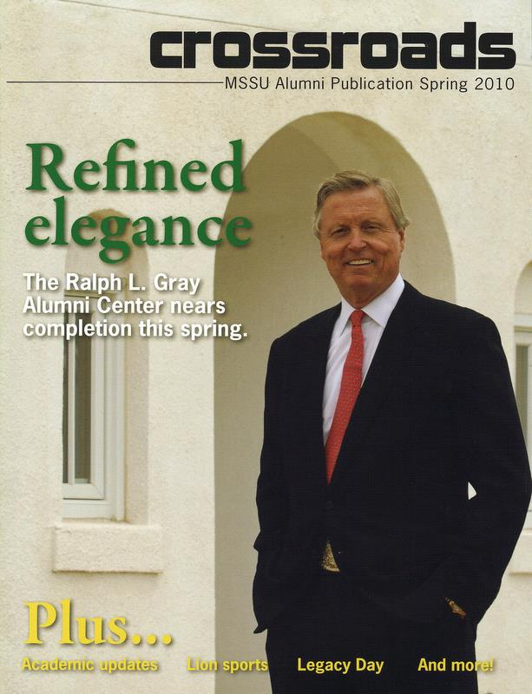
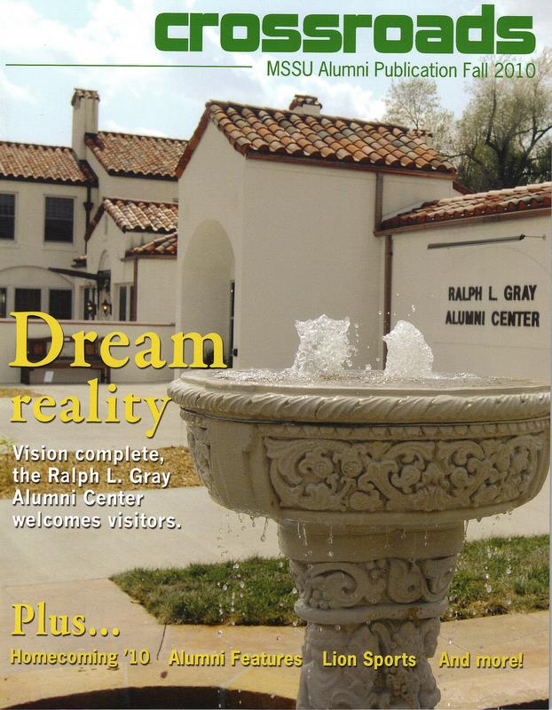
Magazine Success
Notes:
Crossroads magazine has been a wonderful addition to the Alumni Association and is a terrific communication tool for Missouri Southern.
Content for each issue is collaborated between Rhonda Clark, Crossroads advisor and the Alumni Association office. Writing and editing is done by students, staff, and alumni under the supervision of the publications manager. The magazine shares office space, equipment and software with The Chart, as a responsible use of resources.
Distribution of the magazine consists of Alumni Association members, donors and constituents, community members and at Commencement. The magazine is produced twice a year.

Slide 13
Alumni 75th Anniversary Projects & Events
  Production of a 75th Anniversary Book
  Seven by Five Alumni Artist Showcase Event
  Opening Night Event of “The Patsy”
  Specific Departmental Reunions
Notes:
The MSSU Alumni Association is busy with plans for their portion of the 75th Anniversary recognition.
First and foremost is the production of a quality, historic book. Currently, the Alumni Association is researching, interviewing and outlining interesting stories. “In Their Words” is the way the book will be produced … which will include letters, stories and interviews of alumni and friends from each time period. Brad Belk, Alumni Board member is Chairing this project. A budget will soon be completed and will include distribution information.
The Alumni Association also plans to host a specific reunion called “Seven by Five” – featuring a goal of 75 alumni contributed pieces of art on a 7 inch by 5 inch canvas to benefit the Alumni Association Scholarship Fund.
The first ever Joplin Junior College stage production was “The Patsy”. The Alumni Association is working with the Theatre Department to host an opening night reception for alumni and friends as an anniversary event.
And, the Alumni Association is excited to work with a variety of departments to assist with special reunion groups, as needed and as requested by those areas.

Slide 14
Missouri Southern Foundation

Slide 15
Support for MSSU, 2009-2010
Areas of University Support | Annual Amount
Scholarships | $523,125
Faculty and Departments | $299,762
Facilities Improvement | $740,755
General University | $115,032
Cultural Activities | $29,875
Total University Support | $1,708,549
Numbers from Audited Financial Statements, 7/1/2009-6/30/2010

Slide 16
Total Assets/Support to MSSU
2001 | 2002 | 2003 | 2004 | 2005
$20,648,958 | $19,966,822 | $20,667,044 | $21,990,172 | $22,690,098
$1,370,351 | $1,321,815 | $1,140,568 | $1,242,977 | $1,167,211
2006 | 2007 | 2008 | 2009 | 2010
$24,974,343 | $28,249,084 | $26,447,232 | $25,467,844 | $26,325,817
$1,273,174 | $1,643,082 | $3,313,341 | $1,467,624 | $1,708,569

Slide 17
Assets by Class
 | 2001 | 2002 | 2003 | 2004 | 2005
Unrestricted | $1,513,305 | $1,134,357 | $889,563 | $1,075,619 | $1,134,354
Temporarily Restricted | $5,120,388 | $5,036,726 | $5,885,263 | $6,365,159 | $6,492,787
Permanent Endowment | $14,015,265 | $13,726,467 | $13,686,659 | $14,485,919 | $15,002,363
 | 2006 | 2007 | 2008 | 2009 | 2010
Unrestricted | $1,701,248 | $2,223,219 | $1,893,719 | $820,402 | $874,335
Temporarily Restricted | $7,850,787 | $9,414,736 | $9,513,585 | $10,415,112 | $10,482,436
Permanent Endowment | $15,367,655 | $16,559,322 | $15,955,755 | $13,686,659 | $14,426,692

Slide 18
Resource Center

Slide 19
Successes
Emergency Management
  $402,000 Emergency Management in Higher Education award from the U.S. Department of Education to plan and prepare for major natural and/or manmade emergencies.
Missouri Department of Social Services
  $143,000 Child Care Facility Improvement Grant from Missouri Department of Social Services to renovate Child Development.
Service Learning Objectives
  Two courses, a Social Problems course and one University Experience course, redesigned in FY2011 to meet Service Learning objectives. Service Learning hours will be noted on students’ official university transcripts.
Notes:
CDC grant to provide space for infants, enabling the Center to accept children ages six weeks to five years.

Slide 20
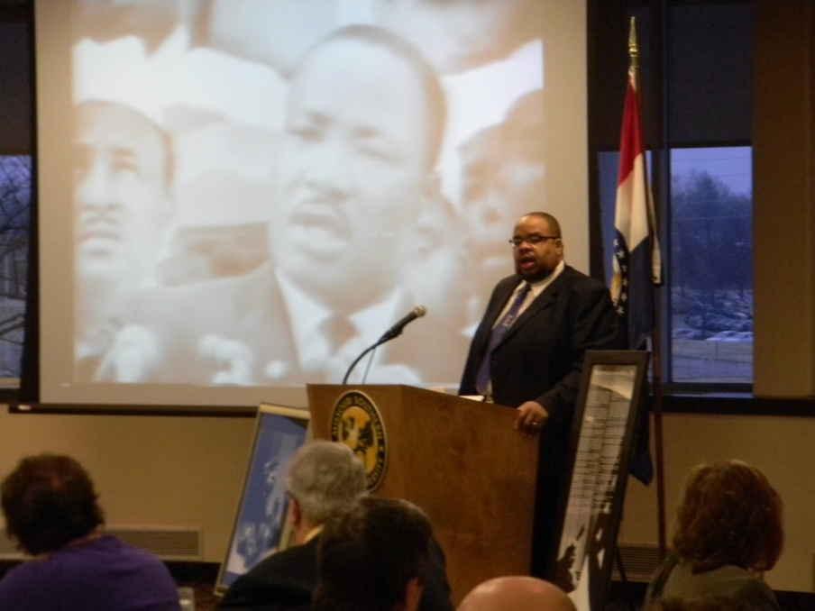
Successes
Campus Diversity
  In conjunction with campus Diversity Committee day of activities and service honor Dr. Martin Luther King, Jr.
  162 volunteers - 9 projects throughout community and on campus
  Nearly 400 hours of service (an economic value of $8,200)
Notes:
CDC grant to provide space for infants, enabling the Center to accept children ages six weeks to five years.

Slide 21
Future Events
Workshops
  Department of Health and Senior Service and The Foundation Center of New York workshops at the Resource Center in May.
Professional Development
A variety of professional development activities associated with the pursuit and development of external funding opportunities, service learning programming, and creative fundraising activities are being prepared for FY 2012.
Community Service Fair
MSSU Resource Center will host a Community Service Fair in August. Nonprofit organizations from the greater Joplin area will share with the MSSU campus community the mission of their organization.
Serv-A-Thon
Week of September 11 in honor of the National Day of Service and Remembrance. The Serv-A-Thon is the Resource Center’s largest annual fundraiser.
Notes:
The goal of the Community Service Fair is to match campus student organizations and departments with nonprofit organizations in preparation for Serv-A-Thon 2011.

Slide 22
Southern Annual Fund

Slide 23
FY 2011
Phonathon callers managed by Wilson-Bennett, under Missouri Southern Foundation supervision
Paid MSSU student callers – 25 hired and employed by MSSU - all calls from MSSU campus
2 weeks rather than 8-10 weeks for Phonathon
Separate campaigns for faculty, staff, boards, businesses, parents, students throughout year

Slide 24
FY 2011 Goals
Increase $ by at least 10% - $71,500 goal – now at $50,000
Increase total donors by at least 10% - goal already met and exceeded
Increase faculty/staff participation by at least 25% - from 60 to 75

Slide 25
Phonathon 2011
DATA 2010 2011
Total Pledges 475 695
Total First-Time Gifts 96 253
Total Unrestricted Pledges app. 300 637
Total Unrestricted Dollars app. $25,000 $38,837
SUCCESSES
More constituents reached – good for relationships and data
More pledges
More first-time gifts
More unrestricted pledges and dollars
More one-time payments = increased dollars in the door
More overall participation

Slide 26
Scholarships
New Endowment Agreements Signed - $40,000 total
  K’Alice Breinig Memorial Scholarship – Nursing
  Debra Snodgrass Scholarship – Piano
  Vada Hainline Fund – Loan fund
  Catholic Campus Ministry/Rev. John Francis (J.) Friedel Scholarship
New Patron/Foundation Scholarships – app. $25,000 total
  Michael Resa Memorial
  20 patron scholarships transferred over from Student Services
  (FY 2012)
Scholarship brochure produced

Slide 27
Major Gifts-Athletics
Secured two seven-figure gifts toward athletic facility from Robert W. Plaster Foundation
First gift includes:
  Baseball field/stadium component – one for one challenge gift up to set amount
  End-zone facility component – provides lead gift that paves the way for further campaign planning
Second gift provides substantial seven-figure lead gift (also challenge gift) that offers opportunity for a future campaign to renovate the stadium

Slide 28
Athletics Facilities Projects
Baseball Advisory Committee & Athletic Department continues work on baseball field/stadium design
Timeline for fundraising campaign is being established; naming opportunities identified
“Spec” book being prepared with assistance of ATG Sports
Major and lead prospect strategies are being developed and implemented; a six-figure gift for baseball was recently secured

Slide 29
Other Campus Fundraising
Ummel Renovation for Biology Labs
  Advisory Task Force established to begin fundraising for Ummel; members being recruited
  Biology Department, Academic Deans, VPAA and medical community leaders are represented
  Design renderings being produced for campaign
Friends of Library contributions now directed to Foundation
  Advisory Task Force being recruited to pro-actively focus on fundraising for strategic priorities of the Library

Slide 30
Future Goals
Critical Database Issues:
  Phonathon – only 37% of calls were completed; and 49% of completed calls were wrong numbers
  Work with IT & President’s Council to solve this problem, such as with new Database Coordinator
  Major need for additional fundraising staff
    Through campaign planning and development audit, recommend level of fundraising staffing necessary and how development staff best deployed to meet campaign goals

Slide 31
Questions/Comments

