Slide 1
Summer Compensation
Kerry Johnson
Mathematics Department Chair
January 25, 2017

Slide 2
Main issues with the traditional Model
Low enrollment classes create revenue loss
Overhead costs not accounted for
Benefit costs were not accurate

Slide 3
Goal
Create a summer pay model that incorporates all university expenses (overhead/benefits) Ad Hoc Committee (Fall 2015) Faculty Welfare Committee Faculty Senate President’s Council Board of Governors (Spring 2017)

Slide 4
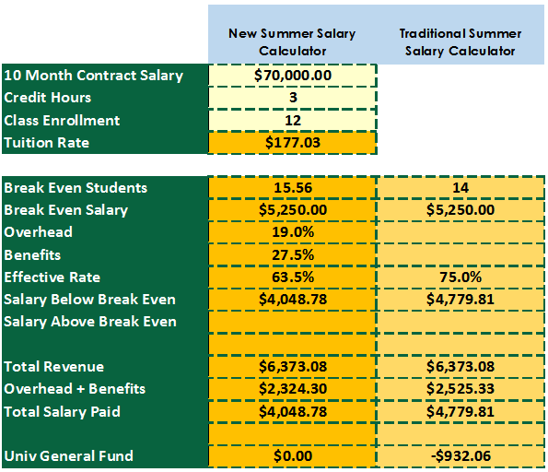
Example 1: Low Enrollment

Slide 5
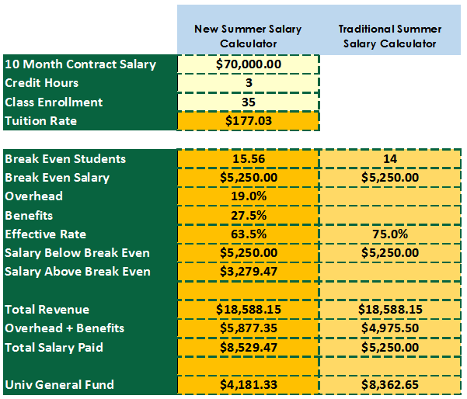
Example 2: High Enrollment

Slide 6
Example 3: Pay scale

Slide 7
Benefits
The new calculator eliminates revenue loss on low enrollment classes. Faculty gain 100% of the tuition revenue after overhead and benefits.
Faculty teaching large enrollment classes earn 50% of the tuition after overhead and benefits.

