Slide 1
Proposal for Management of Missouri Southern State University Prairie

Slide 6
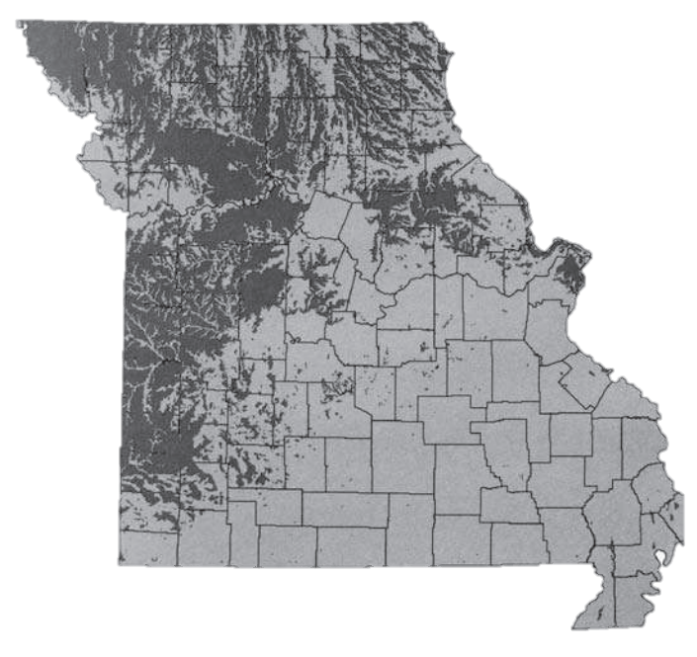
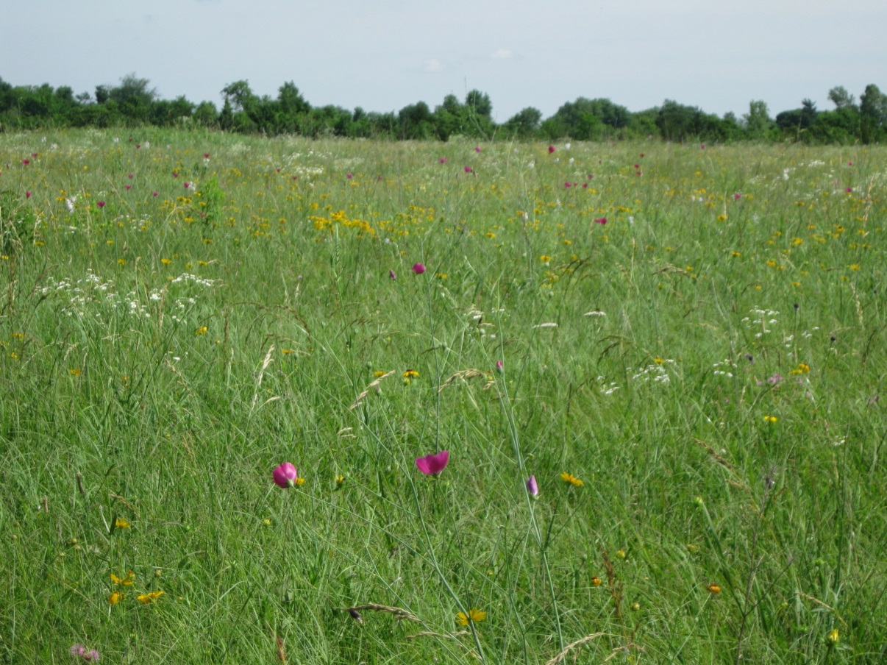
Pre-settlement Prairie in Missouri
Of the estimated 15 million acres of original prairie in Missouri, less than 0.5% remains intact

Slide 7
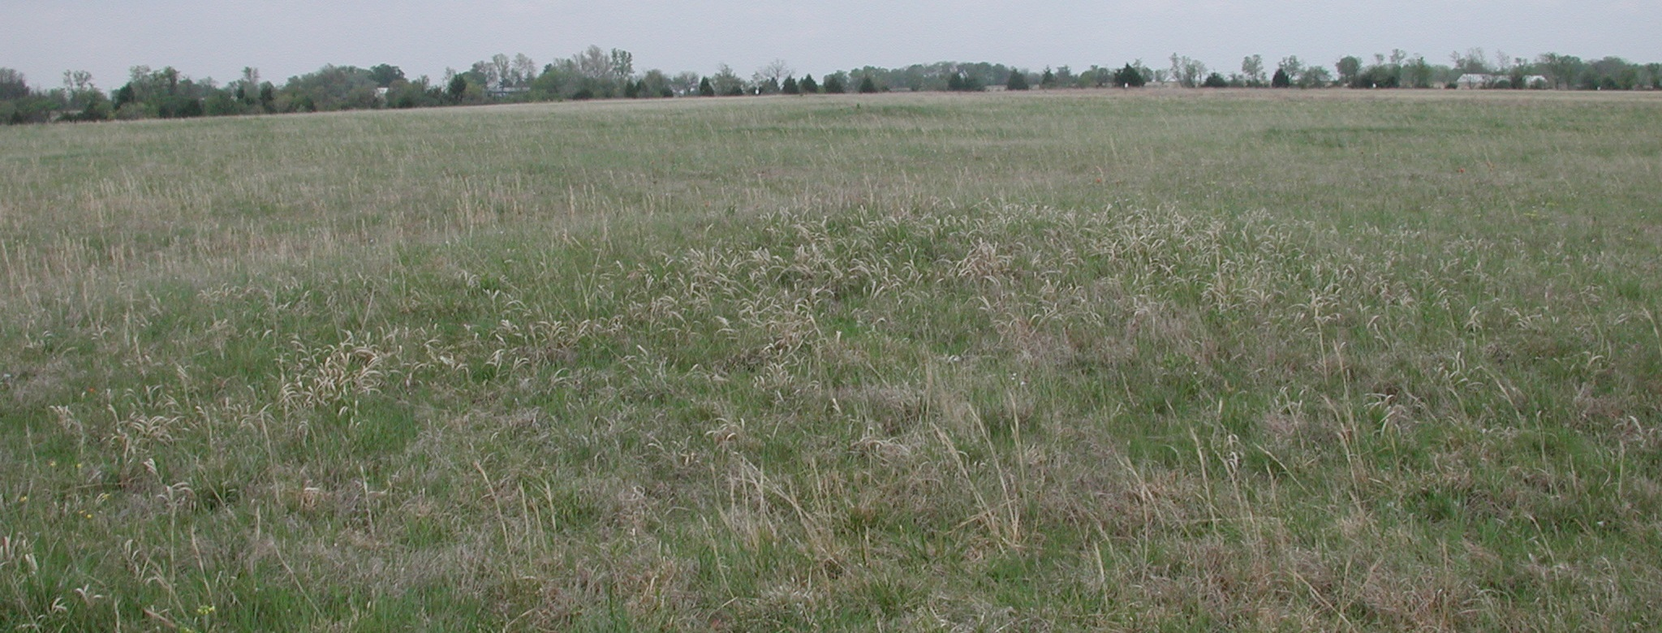
MSSU’s Native Tallgrass Prairie
Appears to have never been plowed
Mima mounds, probably the work of rodents in the post-glacial past (10,000 BC), still dot the prairie
Springtime several of what appear to be buffalo wallows are still visible

Slide 8
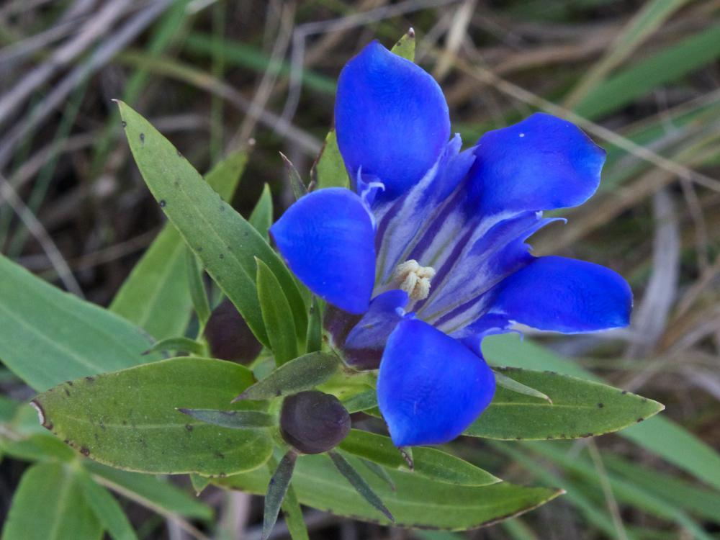
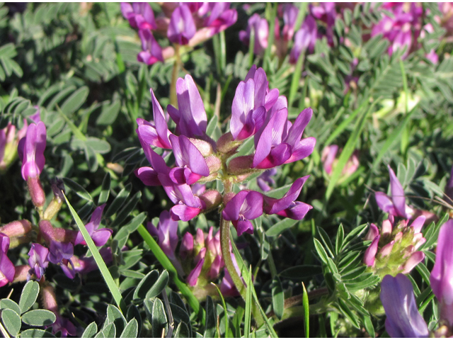
MSSU’s Native Tallgrass Prairie
Diverse vegetation
Several indicator species of high-quality tallgrass prairie
Downy gentian (Gentiana puberula)
Groundplum milkvetch (Astragalus crassicarpus)
Royal catchfly (Silene regia)
Wolf’s spike rush (Eleocharis wolfii)

Slide 9
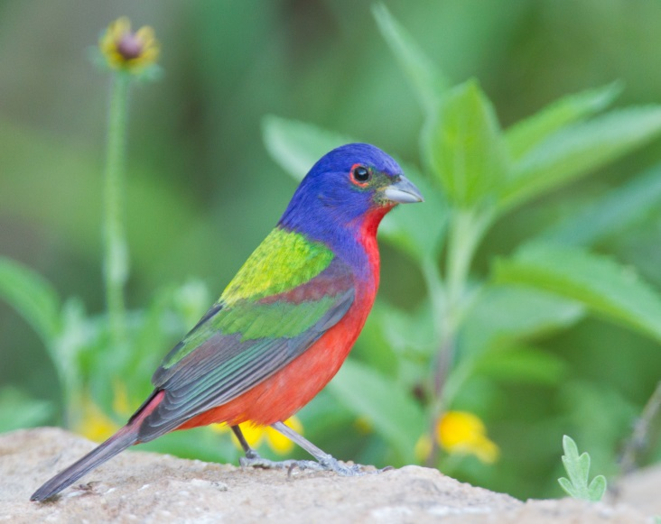
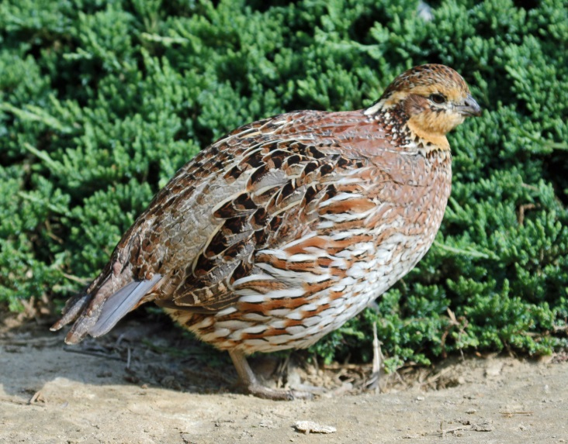
MSSU’s Native Tallgrass Prairie
32 known species of birds on the prairie
Nesting
Grasshopper, field, and song sparrows
Dickcissel
Eastern meadowlark
Bell’s vireo
Painted bunting
Bob-white quail
Winter visitors include
Savannah and LeConte’s sparrows
Common snipe
Smith’s longspur
Short-eared owl
http://upload.wikimedia.org/wikipedia/commons/3/35/Northern_Bobwhite_female_RWD.jpg

Slide 10
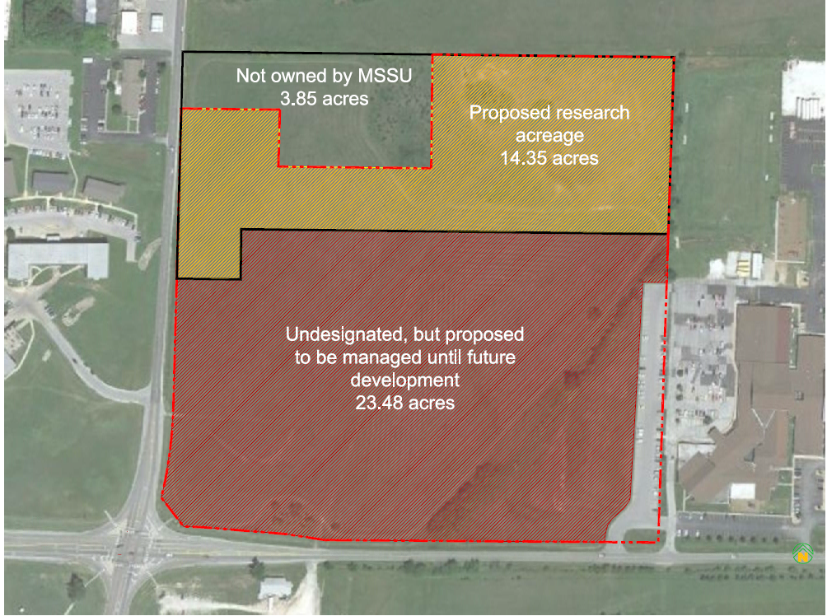

Slide 11
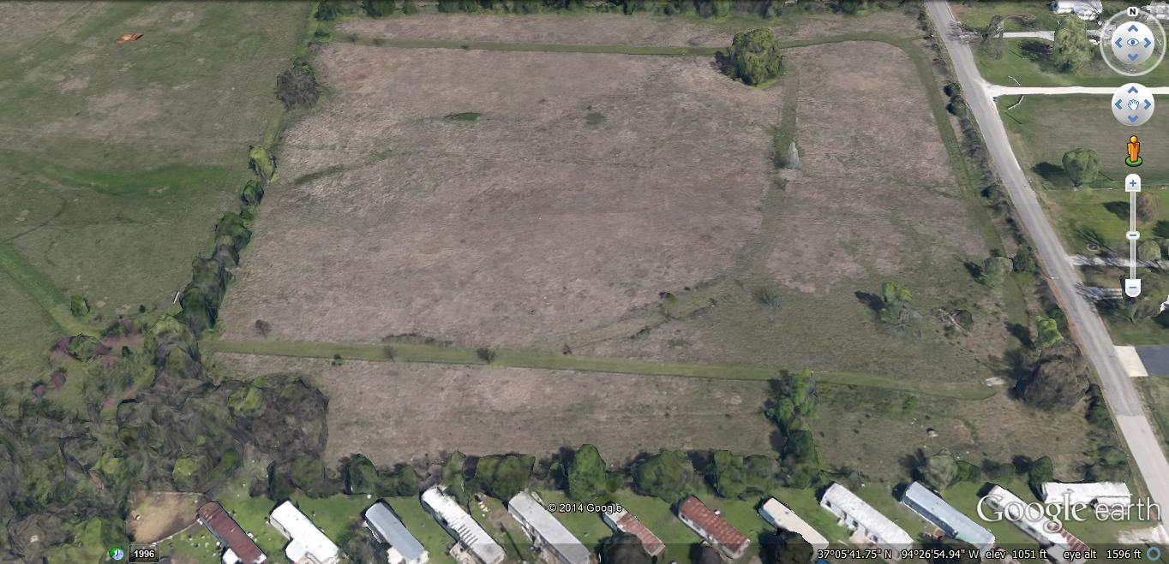
Additional 10 acre tract of prairie

Slide 12
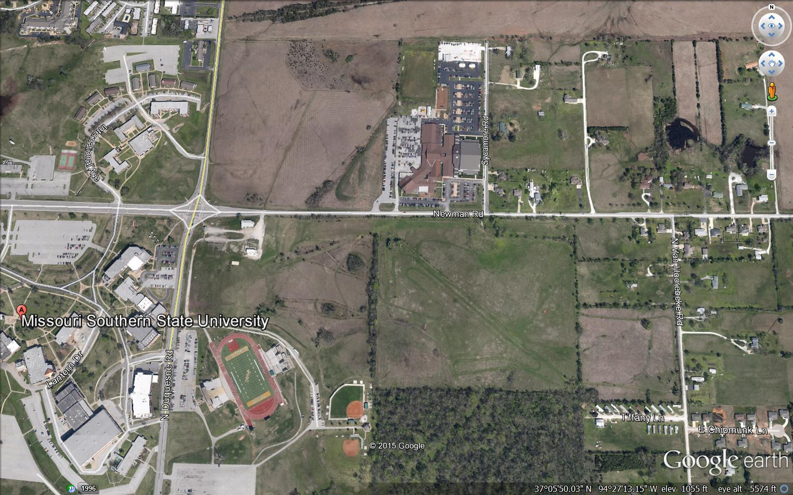

Slide 13
Proposed Uses: Education
Provides unique outdoor classroom
Large, high-quality tract of land
Conveniently located on campus
Used by multiple classes in the Biology and Environmental Health Department

Slide 14
Proposed Uses: Research
Previous
Drs. Messick, Plucinski and Heth
Surveys by MO Dept. of Conservation and MO Native Plant Society
Proposed
Observational studies
Independent student research
Vegetation monitoring plots
Annual collection of rare plant seeds

Slide 15
Proposed Uses: Community Outreach
Offers inspiration for students or community members
Literature, painting, photography, etc...
K-12 outdoor classroom
Assistance from MSSU professors
Birdwatching, walking trail
Collaboration with MO Department of Conservation
Procurement of an official sign

Slide 16
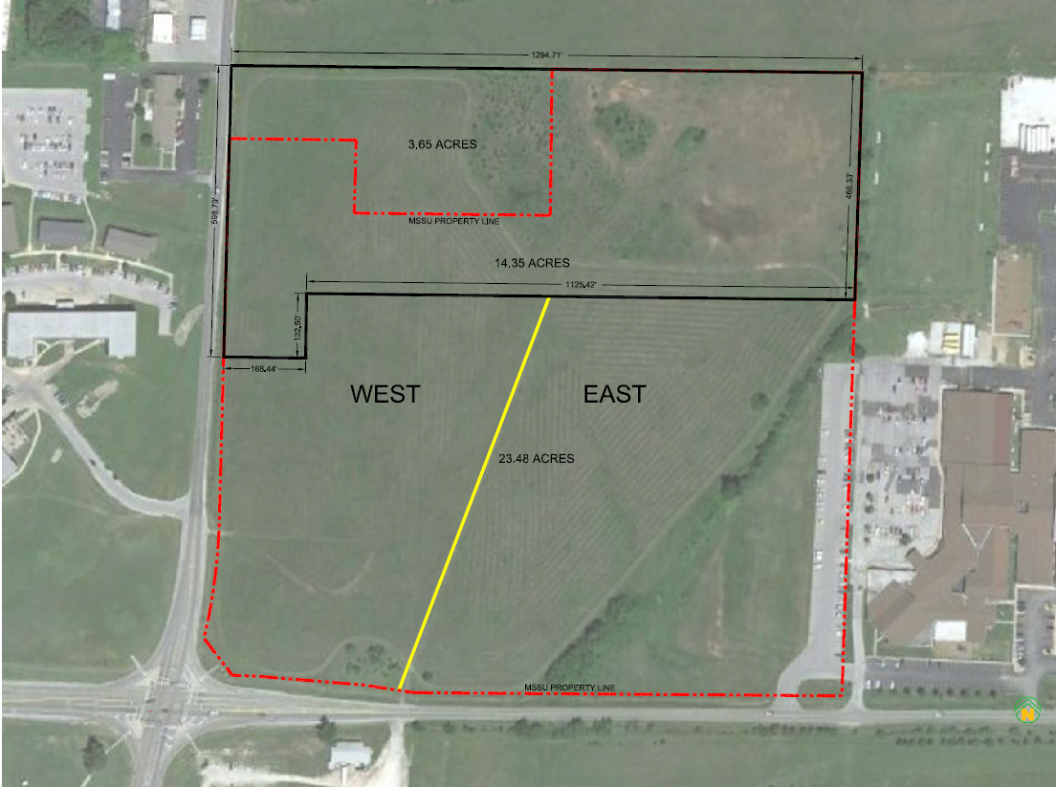
Proposed Management of Undesignated MSSU Prairie
Mowing
Alternating years
Limited to late July to allow for nesting birds and ensure regrowth for winter cover
Limited to two mower widths along trail with raised blade
Limited use of prairie as an excess parking lot
West
East

Slide 17
Proposed Management of Undesignated MSSU Prairie
Removal of invasive, non-native vegetation and woody vegetation
Manual removal, with stump treatment of an herbicide
Removal in late fall-winter timeframe
Plants transfer nutrients to their root systems during the dormant season
Some woody vegetation left as breeding habitat and cover for certain bird species
Trash pick-up
Windblown trash
Currently picked up by MSSU Biology Club

Slide 18
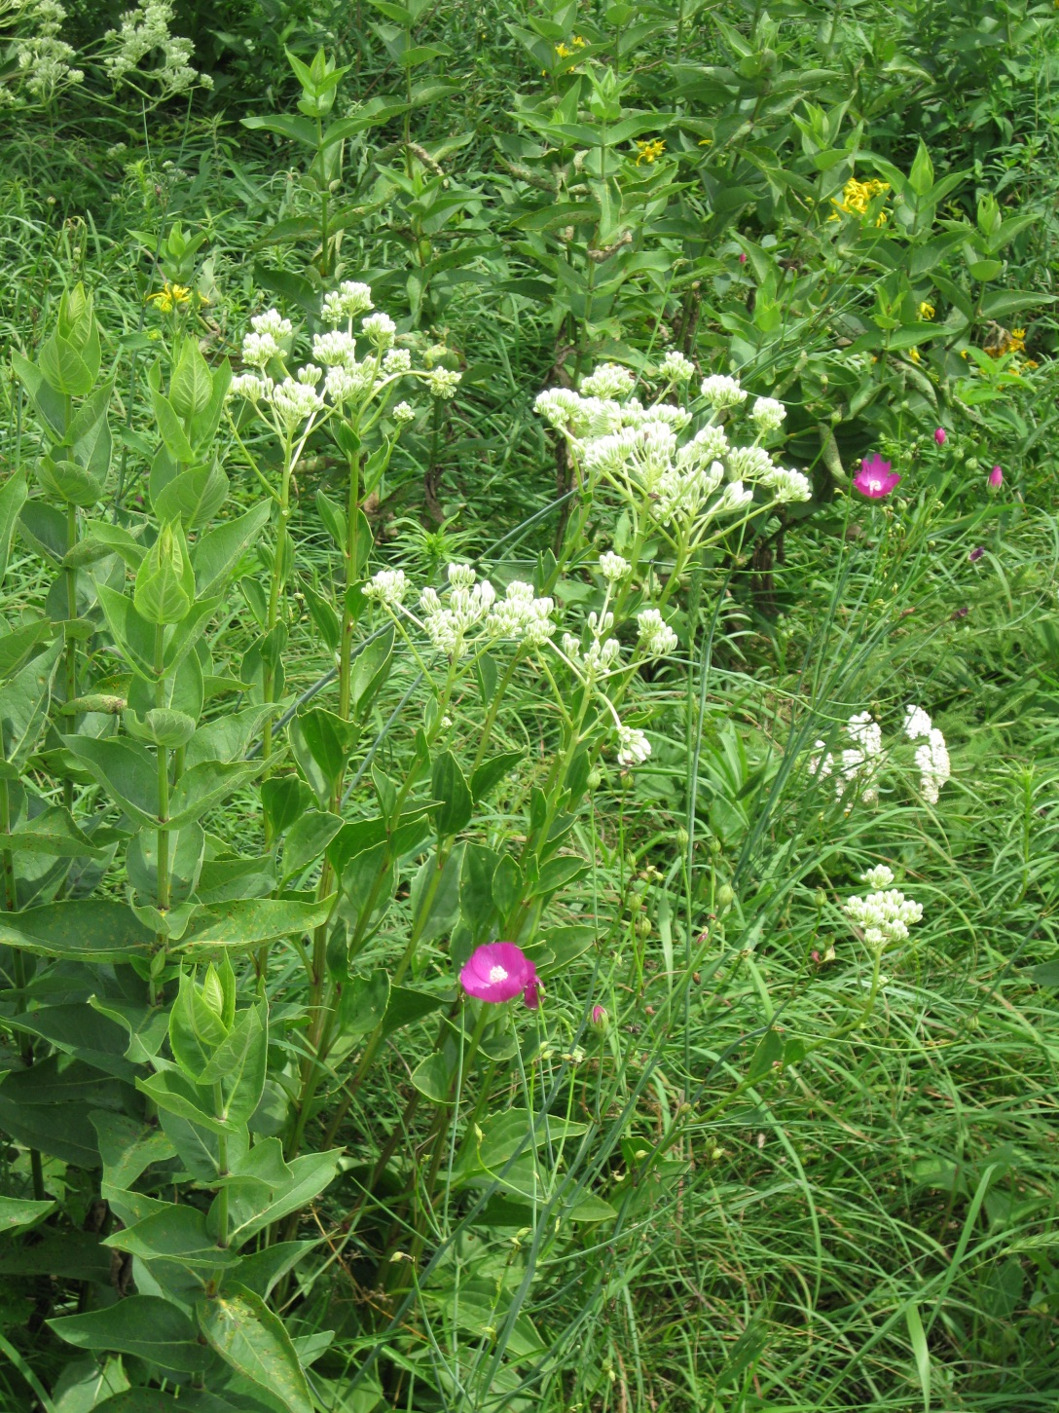
Questions

