Slide 1
GGOE Update

Slide 2
GGOE Culture Committee
Class/Member | Position
Chair/Coach
Scott Cragin | Prof, Business
Staff
*Landon Adams | Dir, Student Activities
*Elisa Bryant | Development Officer,
Randon Coffey | Dir, Athletic Mktg & Corp Sales
Felicia Morley | DL Instructional Designer
Julie Wengert | Dir, Academic Outreach
Faculty
Will Delehanty | Assoc Prof Political Science
Nick Nicoletti | Assoc Prof, Social Science
JJ Spurlin | Assoc Prof, Criminal Justice
Scott Wells | Prof, Biology & Env Health
Jordan Wilson | Prof, Music
Administration
Becca Diskin | Dir, Financial Aid
Wendy McGrane | Assoc Provost/VPAA
*Scott Snell | Dir, Distance Learning
Albert Stadler | CIO
*Josie Welsh | Dir, Inst. Effectiveness
*subcommittee chair

Slide 3
CC Subcommittees
Training: Develop comprehensive training program, synthesize CC member comments, prepare implementation plan.
Communication: Communicate GGOE happenings to the campus community, administer and analyze findings from GGOE surveys, communicate those findings, establish huddle rhythm.
Minigames: Maintain online minigame database; promote minigame training; develop minigame “application” (including requested reward budget) and review those applications before minigames are conducted.
Fall Rollout (ad hoc): Work with other subcommittees to plan the events for the fall rollout, including campus- wide kick-off meeting and a campus-wide minigame regarding training (introductory and financial).

Slide 4
Financial Training Committee
Chaired by Jeff Gibson
Director of Budget & Operations
Chair
Jeff Gibson | Dir, Budget & Operations
Members
*Will Delehanty | Assoc Prof, Political Science
Cheryl Dobson | Registrar
Maryann Mitts | Asst Prof, Kinesiology
Ken Surbrugg | SBTDC Consultant
*Julie Wengert | Dir, Academic Outreach
*CC member

Slide 5
Training Kickoff
Notes:
BY DR. MARBLE:
Return your attention to GGOE…
This is important… as noted earlier… you are empowered to improve…
Our emphasis is now on getting the campus trained…

Slide 7
Training Modules
Introduction: One Blackboard session
Financial: Three parts: Blackboard session (intro); two classroom sessions (revenue, expenses)
Minigames: Two parts: One Blackboard session; one classroom session (design a minigame)
Follow the Action: One Blackboard session (huddle rhythm; wrap-up)
Notes:
BY DR. MARBLE:
Please refer to the card in your info packet [briefly review modules…]
The Introduction Module and Part 1 of Financial Module are ready now!
There are log-in instructions on the card and we will provide lab sessions for those who do not have computers…
You will sign up for financial classroom sessions when you complete part one of the Financial Module on Blackboard…
And now for something completely different… [Start video]

Slide 8
Carpool Karaoke Video Here

Slide 9
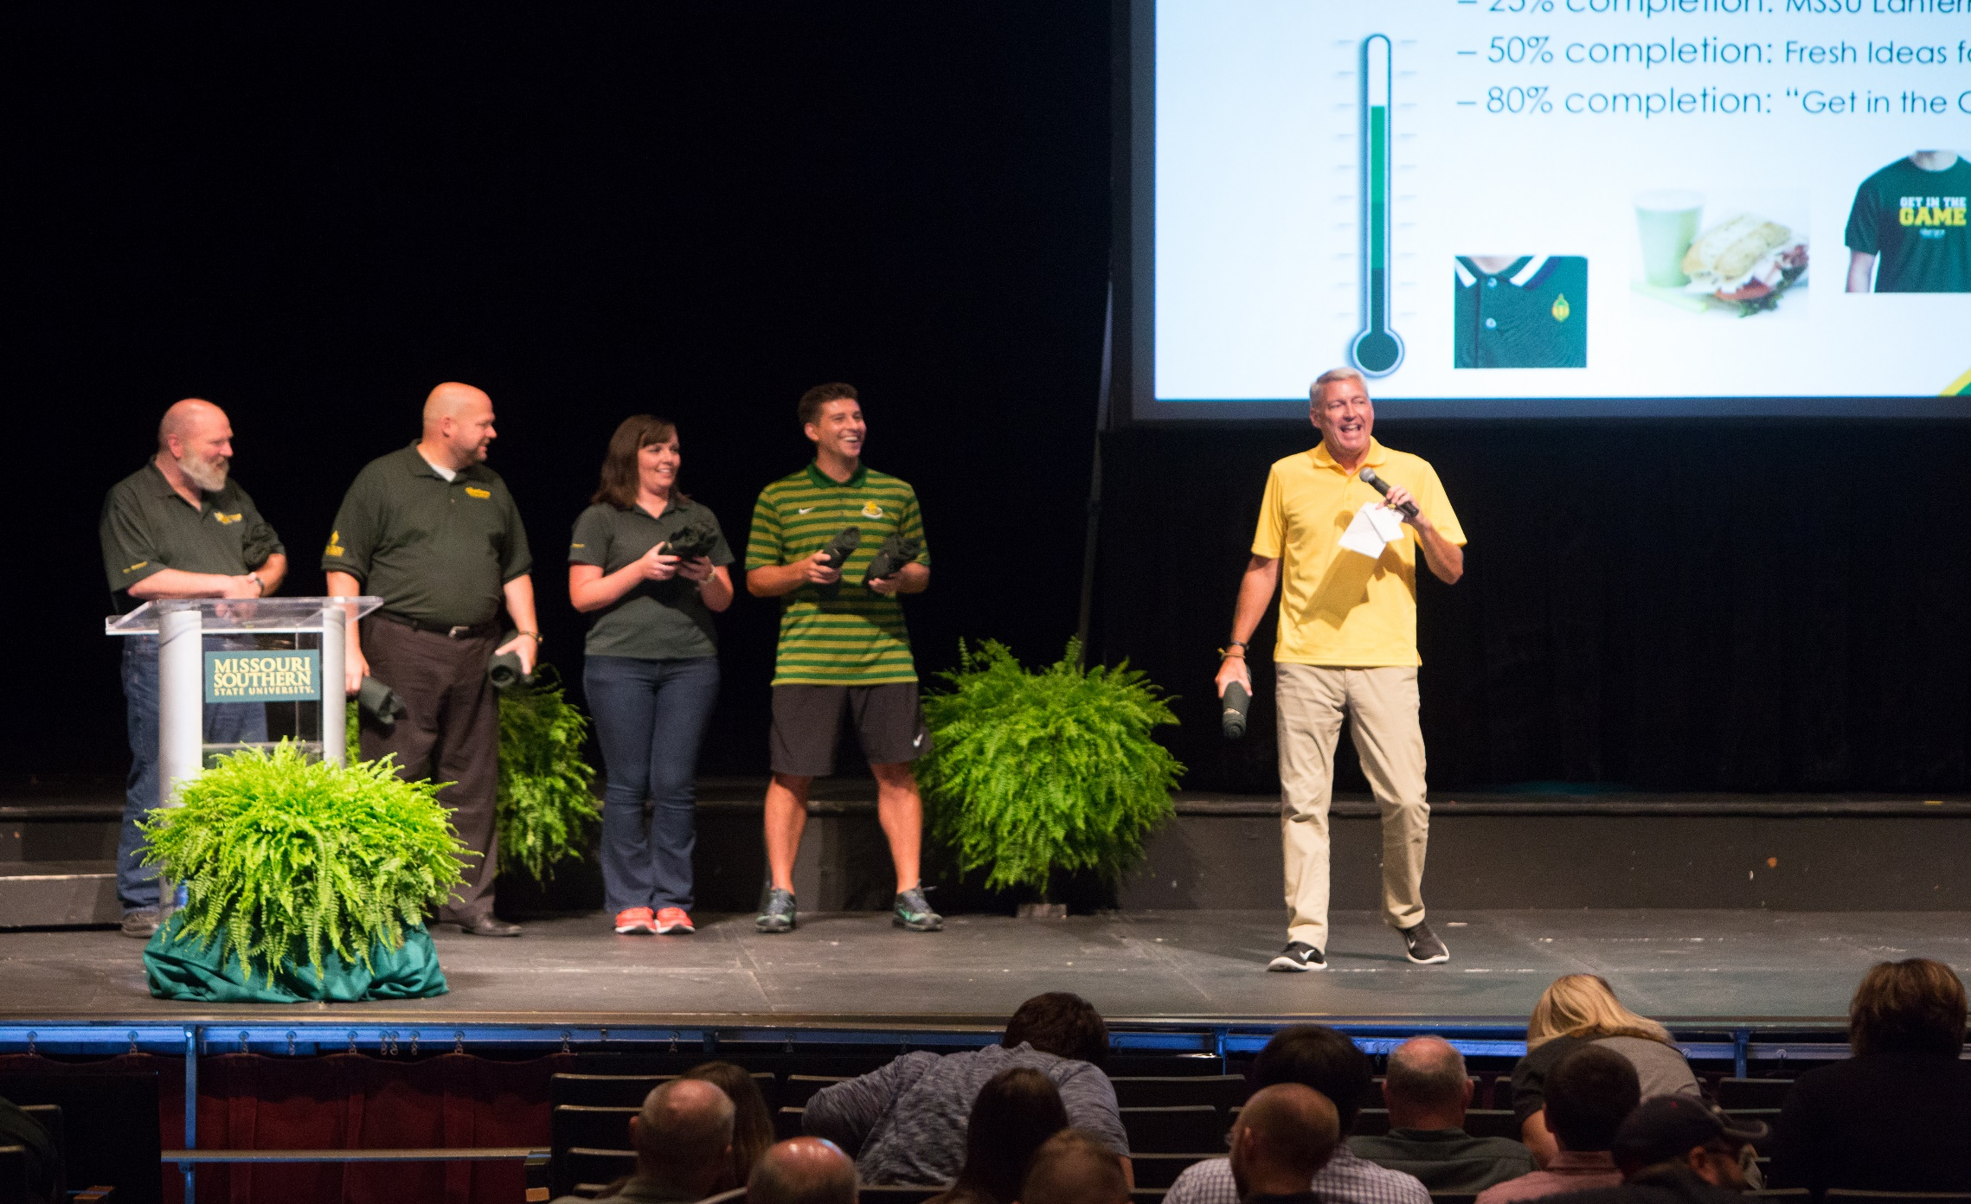
From left: Jim Lile – Prof, Theater; Brad Hodson – Exec. VP;
Sherry Noller – Asst Dir, Career Services; Jeff Boschee – Head Basketball Coach; Scott Wells – Prof, Biology & Env. Health

Slide 10
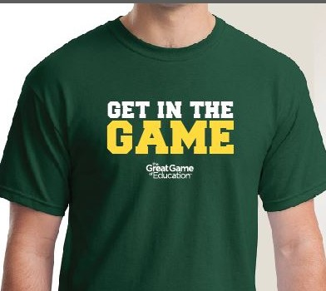
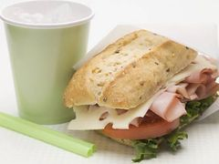
Campus-Wide Minigame
Based on completion of Introduction Module and part one of Financial Module
25% completion: MSSU Lantern lapel pin
50% completion: Fresh Ideas food coupon
80% completion: “Get in the Game” T-shirt
Notes:
BY SCOTT WELLS:
As in incentive for the campus to complete training, we have created a minigame which is explained on the other side of the card… [briefly review goals and swag…]
So everyone needs to get trained and you will all be given the time to complete the training…
So let’s GET IN THE GAME! [Start Me Up begins and shirts fly!]

Slide 11
Questions?

